Slide 1
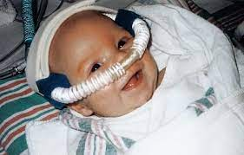
CONTINUOUS POSITIVE AIRWAY PRESSURE (CPAP)
Aida A. Manthar

Slide 2
DEFINITION
Non-invasive respiratory support utilizing continuous distending pressure during inspiration and expiration in spontaneously breathing babies
involves delivering normal air to child's airway at a set pressure, which keeps the airway open and prevents airway obstruction.
CPAP is most commonly used in newborns with breathing difficulties, but is also used to treat severe obstructive sleep apnoea (OSA) and other airway disorders

Slide 3
BENEFITS
• Improves oxygenation
• Reduces work of breathing
• Maintains lung volume
• Lowers upper airway resistance
• Conserves surfactant

Slide 4
INDICATIONS
• Early onset respiratory distress in preterm babies
• Respiratory support following extubation
Consider in babies <32 weeks’ gestation
• Respiratory support in preterm babies with evolving chronic lung disease
• Recurrent apnea (in preterm babies)
• Atelectasis
• Tracheomalacia

Slide 5
CONTRAINDICATIONS
• Any baby fulfilling the criteria for ventilation
• Irregular respirations
• Pneumothorax without chest drain
• Nasal trauma/deformity that might be exacerbated by use of nasal prongs
• Larger, more mature babies often do not tolerate application of CPAP devices well
• Congenital anomalies:
diaphragmatic hernia
choanal atresia
tracheo-oesophageal fistula
gastroschisis

Slide 6
TYPES OF CPAP
1. Standard CPAP
2. Two-level CPAP
3. Bubble CPAP

Slide 7
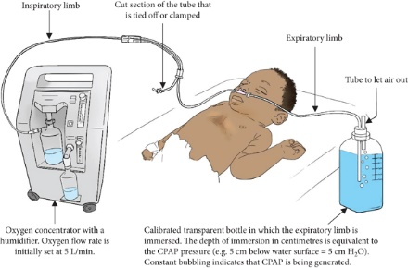
1. STANDARD CPAP
Equipment
Short binasal prongs and/or nasal mask
Circuit
Humidification
CPAP generating device with gas mixing and pressure monitoring
All require high gas flow (usual starting rate 8 L/min)

Slide 9
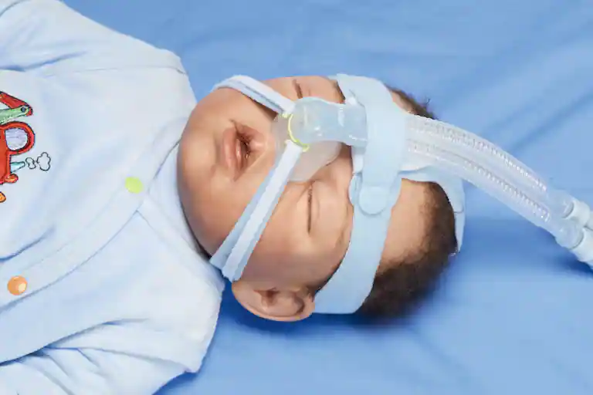
NASAL MASK

Slide 10
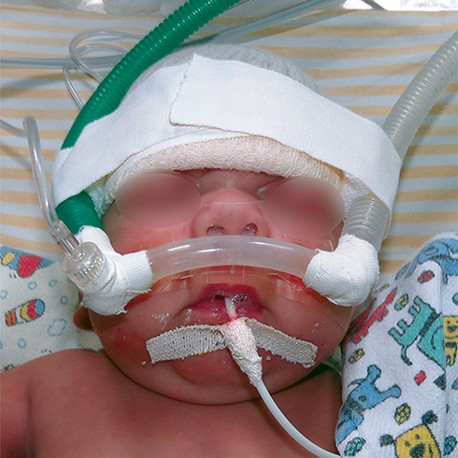
NASAL PRONG

Slide 11
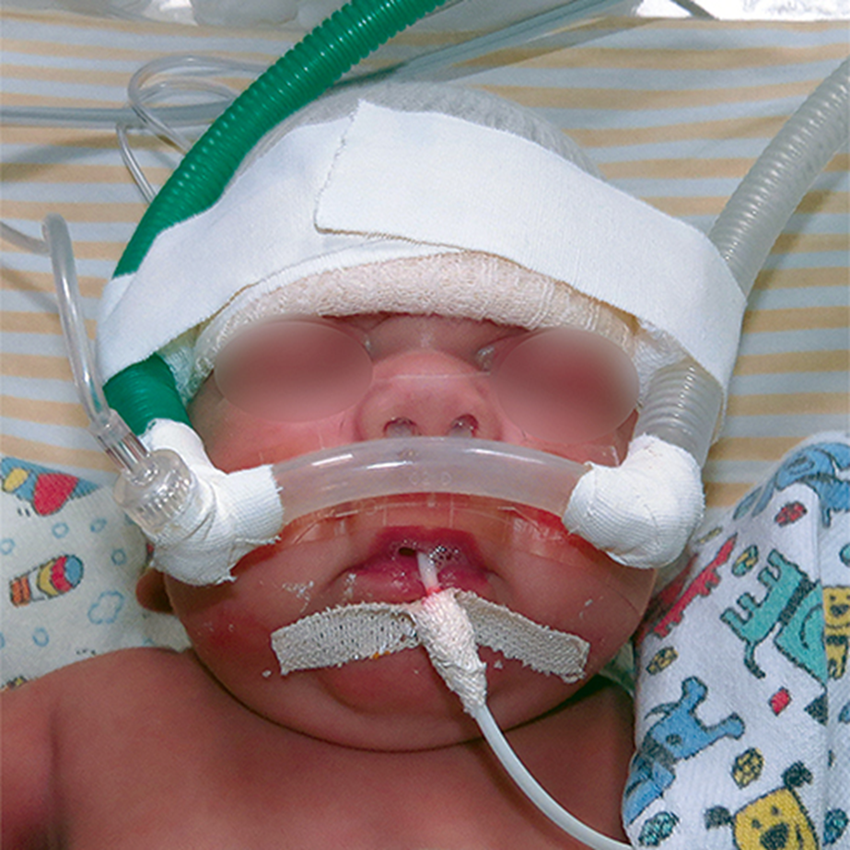
1. STANDARD CPAP
Fixing nasal CPAP device: short binasal prongs (preferred)
To avoid loss of pressure, use largest prongs that fit nostrils comfortably
Ensure device is straight and not pressed hard against nasal septum or lateral walls of nostrils. Excessive pressure can cause tissue damage

Slide 12
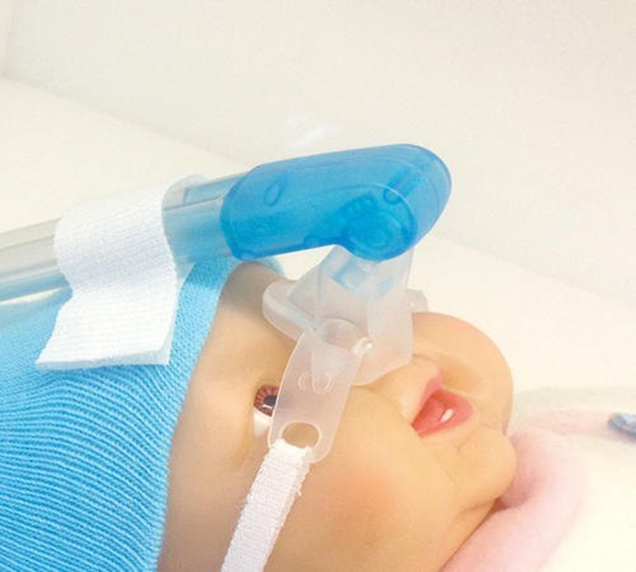
1. STANDARD CPAP
Nasal mask
Fit securely over nose
consider alternating mask with prongs, particularly if baby developing excoriation or erosion of nasal septum. Masks can also result in trauma, usually at the junction between the nasal septum and philtrum
Masks can give a poor seal and can obstruct

Slide 13
1. STANDARD CPAP
Procedure
Position baby
Prone position is preferable
Avoid excessive flexion, extension or rotation of the head

Slide 14
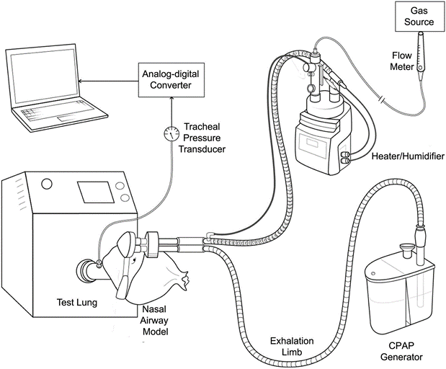
1. STANDARD CPAP Set up equipment (see specific manufacturer instructions)
Connect humidification to CPAP
Connect CPAP circuit with prongs to CPAP device
Place CPAP hat on baby
Turn on CPAP flow and set pressure
Attach CPAP circuit to CPAP hat and apply prongs/mask

Slide 15
CPAP CIRCUIT

Slide 16
1. STANDARD CPAP: Pressure range
Start at 5–6 cm H2O initially and increase by 1 cm H2O increments
Optimum pressure depends on illness type and severity – watch baby and use lowest pressure required to improve work of breathing
High pressures (≥10 cm H2O) may restrict pulmonary blood flow, increase air leak risk and cause over-distension

Slide 17
CPAP 'failure'
'Failure of CPAP' implies a need for ventilation.
Consider intubation and surfactant for preterm babies on CPAP as initial therapy if early chest X-ray demonstrates RDS and
if any of the following apply:
FiO2 >0.3 with CPAP pressure 6 cm H2O
marked respiratory distress
persistent respiratory acidosis
recurrent significant apnea
irregular breathing

Slide 18
Checks: Before accepting apparent CPAP 'failure' exclude:
pneumothorax
insufficient pressure
insufficient circuit flow
inappropriate prong size or placement
airway obstruction from secretions
open mouth

Slide 19
Complications
Erosion of nasal septum: reduce risk by careful prong placement and regular reassessment
Gastric distension: benign, reduce by maintaining open nasogastric tube

Slide 20
Weaning CPAP: When
Start when baby consistently requiring FiO2 <0.3, pressure 5 cm H2O and stable clinical condition
If nasal tissue damage significant, consider earlier weaning

Slide 21
How: 'Pressure reduction' or 'Time off'
Pressure reduction
more physiological approach although can increase the work of breathing if pressure is too low. Has been shown to be quicker than ‘time off’ mode
wean pressures in steps of 1 cm H2O every 12–24 hr. If no deterioration discontinue CPAP after 24 hr of 4–5 cm H2O and minimal oxygen requirement
Time off CPAP
plan using 2 × 12 or 3 × 8 hr time periods

Slide 22
The following regimen of cycling CPAP can be adapted to individual situations

Slide 23
Note: High-flow humidified oxygen therapy
Increasingly used as non-invasive respiratory support
Offers theoretical advantages over CPAP in ventilating upper airway spaces and producing less nasal tissue damage
When weaning CPAP, consider using 5–6 L/min of high-flow humidified oxygen (e.g. Vapotherm® or Optiflow™) rather than low-flow nasal cannulae oxygen or lower pressure CPAP

Slide 24
HUMIDIFIED HIGH NASAL CANNULAE

Slide 25
Failure of weaning
Increased oxygen requirement
Increasing frequency of apneas
Bradycardias
Cyanosis
Increasing respiratory distress
Worsening respiratory acidosis during weaning
should necessitate a review and consider escalation of support

Slide 26
2. TWO-LEVEL CPAP
Two-level CPAP at a rate set by clinician (biphasic) or triggered by baby using an abdominal sensor (biphasic trigger or Infant Flow® SiPAP)
Inspiratory time, pressures and apnoea alarm limit set by clinician
Indications/contraindications as CPAP and can be used when baby’s clinical condition is not improving despite CPAP

Slide 27
Theoretical advantages over CPAP
Improved thoraco-abdominal synchrony
Better chest wall stabilization
Reduced upper airway resistance
Reduced work of breathing

Slide 28
Specific modes of two-level CPAP (specific names vary with manufacturer)
CPAP and apnoea
CPAP with added advantage of apnea monitoring via sensor attached to abdomen
Apnoea alarm triggered when no breaths detected within set time-out period
Biphasic
Bi-level pressure respiratory support with/without apnea monitoring
Higher level pressure above baseline CPAP delivered intermittently at pressure, rate and inspiratory time set by clinician
Not synchronised with respiratory effort
Biphasic trigger (tr)
Bi-level pressure respiratory support with inbuilt apnea monitoring
Higher level pressure above baseline CPAP at rate determined by, and in synchrony with, baby’s respiratory effort sensed through abdominal sensor
Pressure, inspiratory time and back-up rate set by clinician

Slide 29
Clinical use:Biphasic
Begin with CPAP pressure of 5–6 cm H2O
Set peak inspiratory pressure (PIP) at 3–4 cm H2O above CPAP and rate 30 breaths/min
Keep T _{insp} and apnoea alarm delay at default setting
If CO2 retention occurs, review baby and consider increase in rate and/or PIP
Avoid over-distension and keep PIP to minimum for optimum chest expansion

Slide 30
Weaning
By rate and pressure
If rate >30 breaths/min, wean to 30 breaths/min
Reduce Main airway pressure( MAP), by reducing PIP by 1 cm H2O every 12–24 hr
When baby breathing above 30 breaths/min change to biphasic tr mode
When MAP 5–6 cm H2O, change to CPAP Biphasic tr
Begin with CPAP pressure of 5–6 cm H2O with PIP at 3–4 cm H2O above CPAP
Keep T_{insp} and apnoea alarm delay at default setting
Set back-up rate at 30 bpm

Slide 31
PRESSURE Weaning
Reduce MAP by reducing PIP by 1 cm H2O every 12–24 hr
Once MAP 5–6 cm H2O, change to standard CPAP
If deterioration occurs during weaning process, assess baby and consider returning to biphasic mode

Slide 32
3. BUBBLE CPAP
Alternative method of CPAP that may reduce work of breathing through facilitated diffusion
Equipment
• Fisher & Paykel bubble CPAP system:
• delivery system: humidifier chamber, pressure manifold, heated circuit, CPAP generator
• patient interface: nasal tubing, nasal prongs, baby bonnet, chin strap

Slide 33
3. BUBBLE CPAP:Procedure
• Connect bubble CPAP system to baby as per manufacturer’s instructions
• Ensure appropriate size nasal prongs used
• Bubble CPAP nasal prongs are designed not to rest on nasal septum. Ensure prongs not resting on the philtrum nor twisted to cause lateral pressure on septum, and allow small gap between septum and prongs
• Commence at pressures of 5 cm H2O

Slide 34
Bubble CPAP failure : As in standard CPAP
Consider intubation and surfactant for preterm babies on CPAP as initial therapy if early chest X-ray demonstrates RDS and
if any of the following apply:
FiO2 >0.3 with CPAP pressure 6 cm H2O
marked respiratory distress
persistent respiratory acidosis
recurrent significant apnea
irregular breathing

Slide 35
Before inferring bubble CPAP failure:
Ensure baby has been receiving bubble CPAP appropriately by checking for continuous bubbling in CPAP generator
lack of bubbling can result from pressure leaks in the circuit or baby

Slide 36
THANK YOU

